Slide 1
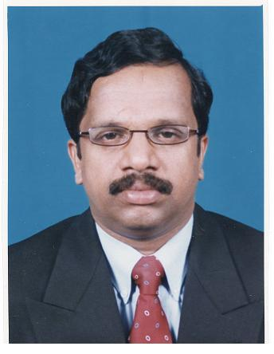
HOD’s Report 27-04-2020
Dr. Unnikrishnan P.C.
Professor and HOD, EEE
email:
unnikrishnanpc@rajagiritech.edu.in

Slide 2
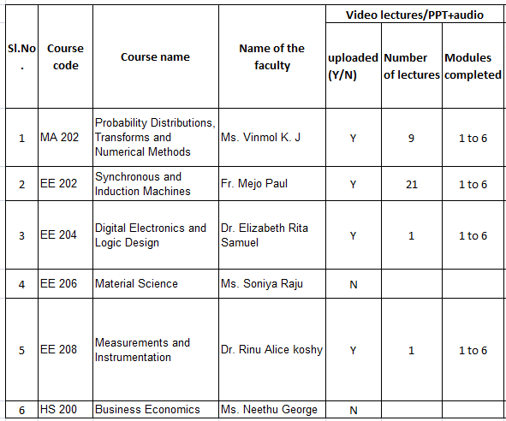
S4 EEE

Slide 3
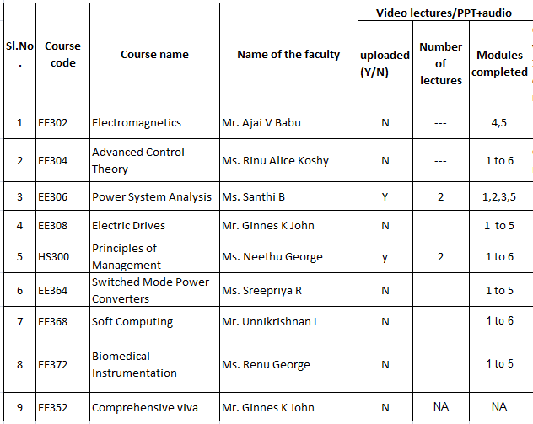
S6 EEE

Slide 4
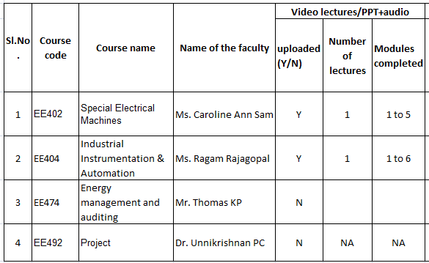
S8 EEE

Slide 5
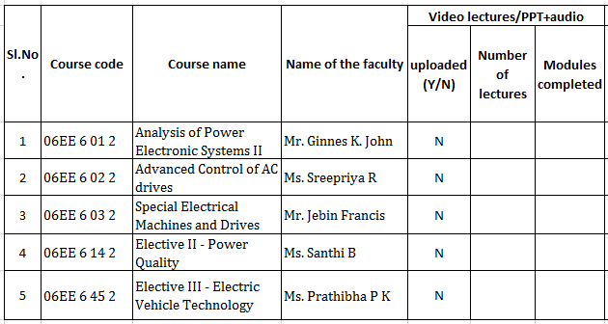
S2 IDAC

Slide 6
S4 IDAC
The Project coordinator has contacted all students (8 students) to enquire about the status of their Project work and proper guideline were given.
All students have submitted their draft main project report.
Evaluation in progress.

Slide 7
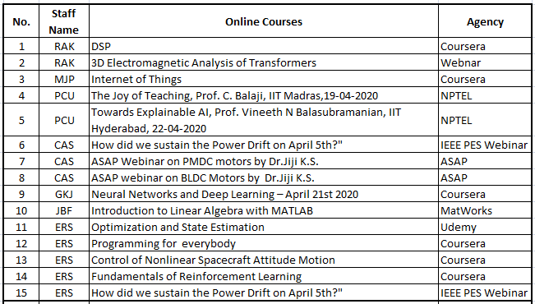
Learning and Research
Online Courses

Slide 8
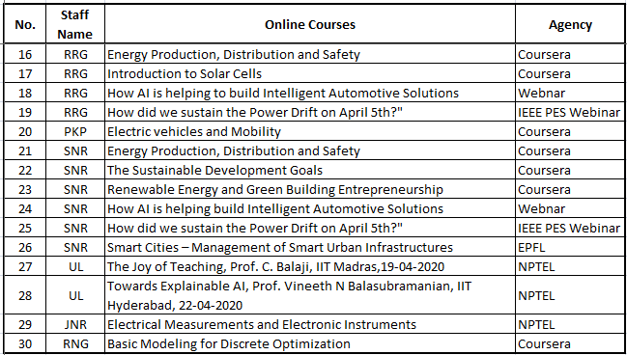
Learning and Research
Online Courses

Slide 9
Learning and Research
Involvement in Covid19 related activities (Projects/Social activities etc.)

Slide 10
Thank You

