Slide 1
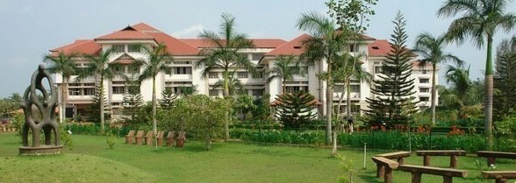
Electronics and Communication Engineering
Activities during locked down 15-04-2020 to 22-04-2020
Dr. Jobin K Antony, HoD
Notes:
Welcome

Slide 2
Academic activities
6 more video lectures/ppt+audio are prepared and uploaded in the website
All teachers have completed the 5th module of their course
All teachers have given 2nd assignment and completed the evaluation also.
M.Tech: 3 modules are over.
Faculty members are offering Online classes as per the published timetable(canvas, google meet, zoom)

Slide 3
Academic activities
M.Tech: 1st series 2 tests pending are conducted-evaluation is over
5 faculty members registered for giving online lectures through ASAP
Online courses registration
More Faculty members as well as students have
registered for online courses
CLASS | No. of students
S4EC A | 39
S4EC B | 32
S4EC C | 35
S6EC A | 52
S6EC B | 44
S6EC C | 45
S8EC A | 10
S8EC B | 9
S8EC C | 15
M.Tech | 29
Courses registered by faculty members | Courses registered (this week)
57 | 12

Slide 4
Co-curricular
Planned a Webinar on “System Verilog”
Planned a webinar for students on “Career after lock-down”
Design contest by “electronauts”

Slide 5
Research activities
Dr. Jayanthi V.S, Anoop Thomas, Dr. Jobin K Antony
Preparing a proposal DST (Matrics) scheme, SUPRA etc
Dr. Sreekumar
Re-reviewed the modified journal paper on Biocybernetics and Biomedical Engineering
(Elsevier Publication, SCI Indexed)
Harsha A
Discussions on Covid19 regarding activities initiated in BIRDS Rajagiri

Slide 6
THANK YOU

