Slide 1

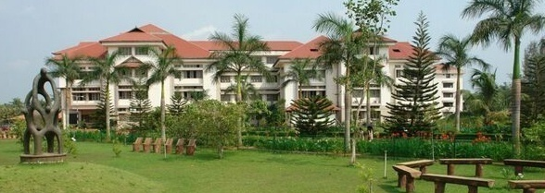

Electronics and Communication
Engineering
Activities during locked down 12-03-2020 to 14-04-2020
Dr. Jobin K Antony, HoD
Notes:
Welcome

Slide 2
Academic activities
Faculty members are offering Online classes as per the published timetable(canvas, google meet, zoom)
80 video lectures/ppt+audio are prepared and uploaded in the website
All teachers have completed the 5th module of their course, and few are completed the last module: B.Tech
All teachers have given 2nd assignment and many are completed the evaluation also.
M.Tech: 3 modules are over.

Slide 3
Academic activities
M.Tech: 1st series 2 tests pending are conducted
M.Tech teachers are preparing question papers for the university examination
5 faculty members registered for giving online lectures through ASAP
Online courses registration
Faculty members -51 courses
Students
CLASS | No. of students
S4EC A | 39
S4EC B | 32
S4EC C | 35
S6EC A | 52
S6EC B | 44
S6EC C | 45
S8EC A | 10
S8EC B | 9
S8EC C | 15
M.Tech | 29

Slide 4
Co-curricular
Online programs –electronauts-Ms. Shyama Sreekumar
2 online quizzes
One online puzzle
Planning to conduct few more online design contests
Automated Robo Soap/Sanitizer Dispenser
By
Jerin Peter II semester

Slide 5
Research papers communicated
Dr. Simi Zerine Sleeba
Title: “Traffic aware routing in 3D NoC using interleaved asymmetric edge routers
Journal : Nano Communication Networks Journal, Elsevier Publishers
Dr. Jayanthi V.S
Book chapter on
1. “Convolutional Neural Network for Biomedical Applications” in the Book
Titled “Computational Intelligence and Its Applications in Healthcare”, ISBN: 9780128206041, Elsevier
2. Book chapter on “Alzheimer's Disease Classification Using Deep Learning” in the Book Titled
“Computational Intelligence and Its Applications in Healthcare”, ISBN: 9780128206041, Elsevier

Slide 6
proposals
Proposal has been sent for AICTE (ATAL) FDP on VLSI , by Dr. Jobin, Kiran and Anoop Thomas
Preparing proposal for DST(SUPRA) by Dr. Jobin, Anoop Thomas
Proposal has been sent for AICTE (ATAL) FDP by Dr. Jayanthi V.S
Preparing research papers for couple of conferences

Slide 7
THANK YOU

